Slide 1
Technology & Operations
Case Challenge Proposal
LIN Shuya, Lencia
LU Wenxin, Violet
YAO Xinjie, Abby
09/08/2017

Slide 2
Agenda
Current Situation
Solution Overview
Process Flow
Demo
Feature Highlights
Expected Impact
Future Improvements
Contingency Plan
Q & A

Slide 3
Current Situation
01

Slide 4




Roadblocks
Current Situation
Data Discrepancy
- Single market data source
- Stale static data
Low P&L
Reporting Efficiency
75 man-hour per day

Slide 5
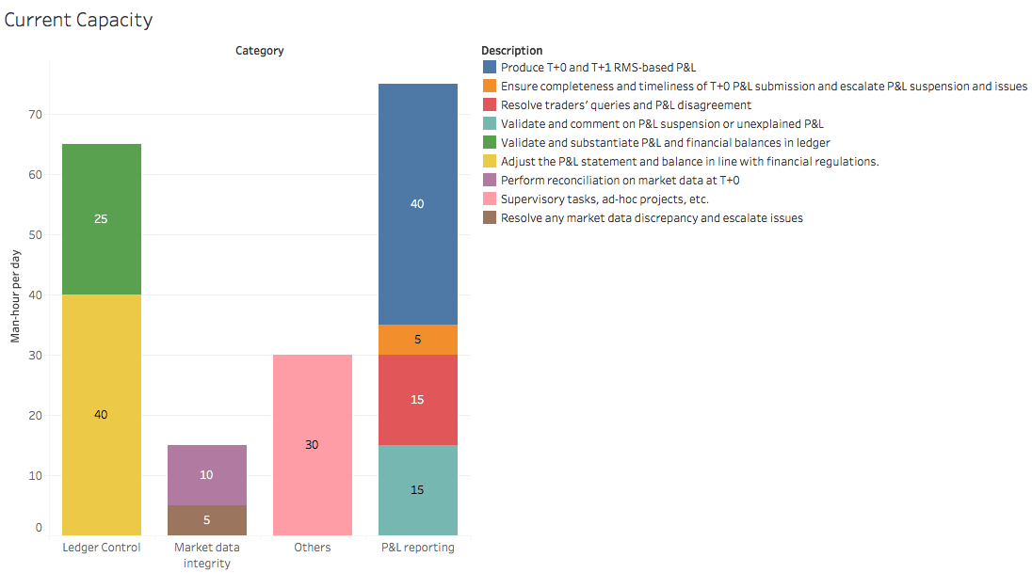

Slide 6
Roadblocks
Current Situation
Data Discrepancy
- Single market data source
- Stale static data
Lack of support desk coverage for late working hours
From 7:30 p.m. to 9:00 p.m
Low P&L
Reporting Efficiency
High labor cost
75 man-hour per day
In core locations
E.g. Hong Kong, Singapore, Japan

Slide 7
Solution Overview
02

Slide 8

I. MarketBox Update
Solution Overview
Reuters
10:04
MarketBox
10:08
Bloomberg
09:58
HKEx
10:09
Yahoo Finance

Slide 9
II. StatBox & WorldDating Update
Solution Overview
World
Dating
StatBox
Weekly update of static data
E.g. instrument information,
Symbol of currency, etc.
Monthly update of calendar information
Manual update on special occasions
E.g. No.8 Typhoon signal, etc.

Slide 10

III. Introduction of DataVeri
Solution Overview
DataVeri
a web-based long-hour
operating and monitoring system

Slide 11
IV. Offshore Late-hour Support Desk Coverage
Solution Overview
Indian Office:
- Low human capital costs
~20% of Hong Kong
- Compatible time difference
2.5 hours later than Hong Kong

Slide 12

V. Outsource Ad-hoc projects
Solution Overview
Reduce Manpower Capacity
Reduce both mean and variance in
Required manpower capacity
Increase efficiency
Consulting firms are more specialized
In dealing with unexpected situations
Consulting Firms
Digital solutions
No additional Costs
The reduce in manpower costs will
Roughly cancel out additional costs
Ad-hoc projects

Slide 13
Process Flow
03

Slide 14
During Trading Hours
Process Flow
01
02
03
Traders book trades
Trades pushed into and shown in DataVeri
Real-time position change updates

Slide 15
On Day End
Process Flow
DataVeri validates quotes and static data
DataVeri generates P&L report row by row
Traders check each row of reports online and submit reconciliation if needed
Email sent to trader and related teams upon submission of reconciliations
Related team check and approve reconciliations
P&L report sent to MoneyClip for report production

Slide 16
Demo
04

Slide 17
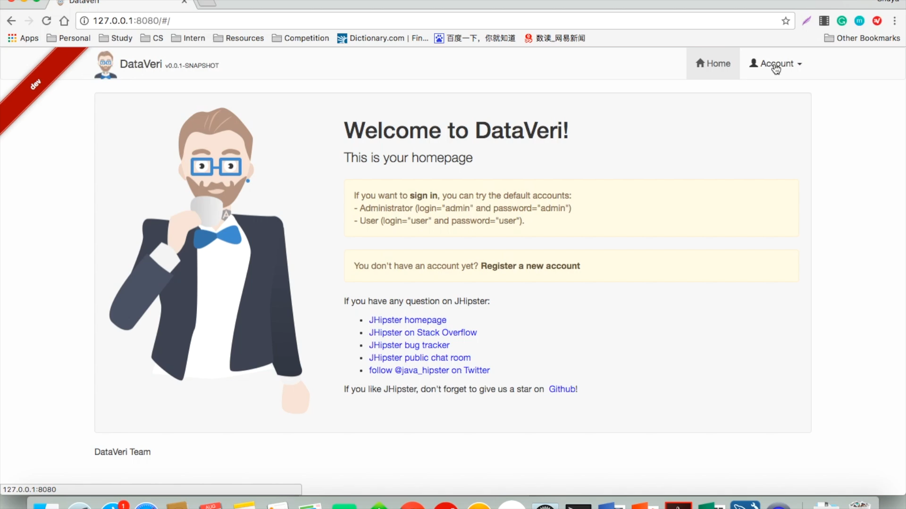

Slide 18
Feature Highlights
05

Slide 19

Feature Highlights
Real-time transaction tracking
Market Data Verification
Static Data Verification
Automatic email notification on reconciliation submission and data verification failure
Synchronous presentation of marginal P&L report during generation
Web-reporting in substitute of self-maintained spreadsheets
Restful API for connection with currently existing systems
Access control for portfolios and transaction records

Slide 20
Contingency Plan
06

Slide 21

Contingency Plan
Daily backup of data
Server 1
Server 3
Sync
Sync
Server 2
Server 4

Slide 22
Contingency Plan
Daily backup of data
Server 1
Server 3
Sync
Sync
Server 2
Server 4

Slide 23
Expected Impact
07

Slide 24
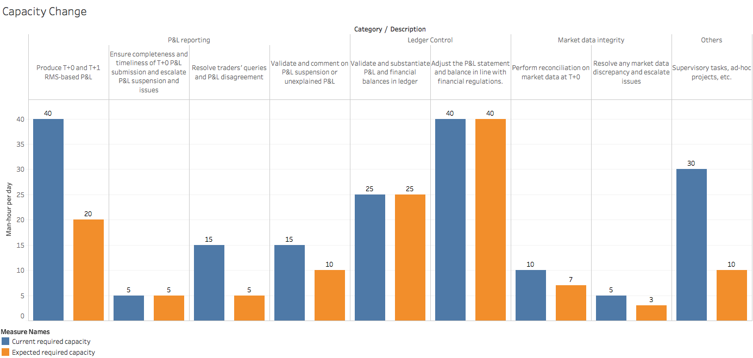

Slide 25
Financial Impacts
Expected marginal changes on P&L reporting operation costs (HKD per month)
Function | Marginal Change in costs
Reduced Manpower capacity | -185,000
Reduced labor cost due to offshoring late hour support to Indian office | -69,200
Additional cost for outsourcing Ad-hoc projects to external firms | +75,000
Additional system testing and maintenance costs for the new system | +61,700
Total | -117,500
$

Slide 26
Future Planning
08

Slide 27
Day 180
Future Planning
Adopt to other departments
Day 0
Day 60
+
Complete replacement of the old system
Continue use in Equity Trading Desk
Implement
the new system
0
-
Additional changes and improvements

Slide 28
Q & A
09

Slide 29

Thank you for listening!

Slide 30
Appendix
10

Slide 31
Calculations for financial impacts
Appendix
Expected marginal changes on P&L reporting operation costs (HKD per month)
Function | Marginal change | Calculation
Reduced manpower capacity | -185,000 | 60hour/day/(10hour/day)*370000HKD/year/(12month/year)
Reduced labor cost due to offshoring late hour support to Indian office | -69,166,67 | 3hour/day/(10hour/day)*(370000HKD/year-65000HKD/year)/(12month/year)
Additional cost for outsourcing Ad-hoc projects to external consulting firms | +75,000 | 1.5*600000HKD/year/(12month/year)
Additional system testing and maintenance costs for new system | +61,666.67 | 2*370000HKD/year/(12month/year)
Total | -117,500

Slide 32
Source Code
Appendix
Check out our DataVeri at:
https://github.com/lencialam/DataVeri

Slide 33
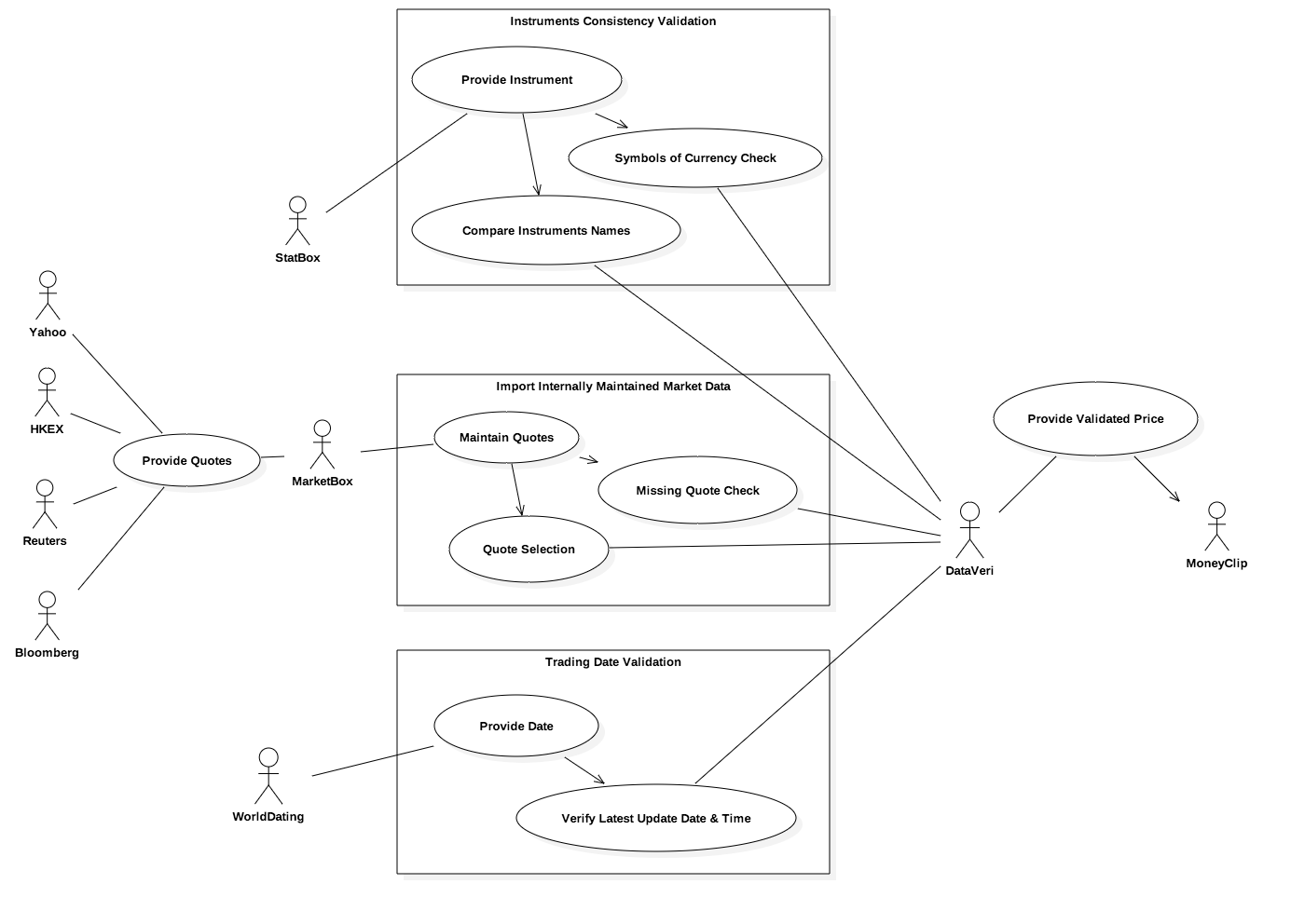
Use Case Diagram
Appendix

Slide 34
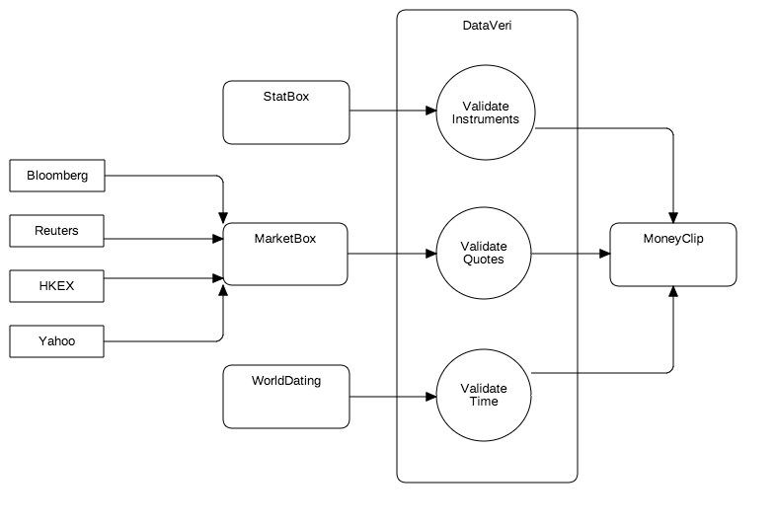
Data Flow Diagram
Appendix

Slide 35
References
Appendix
Glassdoor, (2017). https://www.glassdoor.com/Salaries/hong-kong-management-consultant-salary-SRCH_IL.0,9_IC2308631_KO10,31.htm
Kelly India, (2016). http://www.kellyservices.de/uploadedFiles/India_-_Kelly_Services/New_Smart_Content/Business_Resource_Center/Workforce_Trends/IN-salary-guide-2015.pdf
Mohanan, S., (2016). https://www.morganmckinley.com.hk/article/banking-financial-services-2016-salary-survey-guide
Mortlock, S., (2016). http://news.efinancialcareers.com/au-en/241788/banking-it-pay-in-hong-kong
Payscale Human Capital, (2017). http://www.payscale.com/research/IN/Job=Technical_Support_Specialist/Salary
Payscale Human Capital, (2017). http://www.payscale.com/research/HK/Job=Technical_Support_Specialist/Salary
Payscale Human Capital, (2017). http://www.payscale.com/research/TH/Job=Information_Technology_(IT)_Manager/Salary
Payscale Human Capital, (2017). http://www.payscale.com/research/IN/Job=Business_Analyst%2c_IT/Salary
Payscale Human Capital, (2017). http://www.payscale.com/research/HK/Job=Business_Analyst%2c_IT/Salary
Payscale Human Capital, (2017). http://www.payscale.com/research/TH/Job=Business_Analyst%2c_IT/Salary

